Slide 1
Healthwatch North Somerset
Annual Report 2018/19

Slide 2
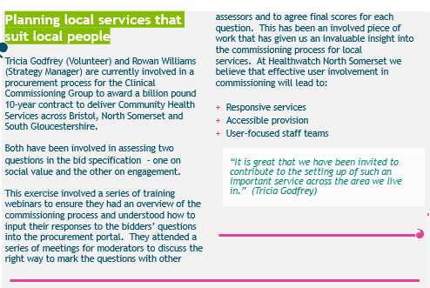

Slide 3
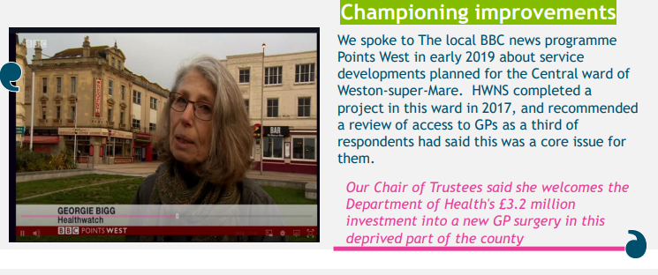
We have watched and reported on developments affecting patients at Graham Road and Clarence Park surgeries for many years.
Your opinions, comments and contributions have been entered into the HW database that feeds up to commissioners. NHS England have now invested an extra £1.4 million locally to ensure that a modern city centre Surgery opens in 2020

Slide 4

Making a difference by highlighting gaps in young peoples mental health support to those that plan services.

Slide 5
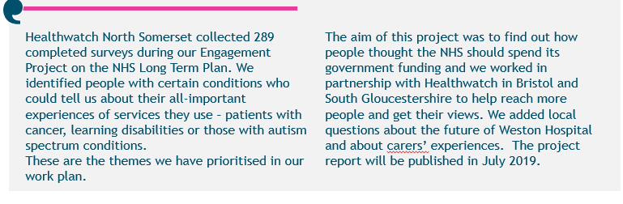
NHS Long Term Plan engagement project
in North Somerset
An executive summary of the report for the three Healthwatch areas is available today at the back of the room

Slide 6
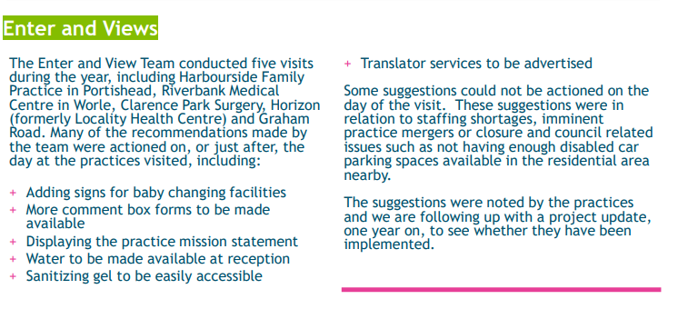

Slide 7


OUR MISSION
By offering all people of Bristol, North Somerset & South Gloucestershire a strong voice we will improve the quality of local Health and Social Care

Slide 8


How we'll continue to work
We will listen to all members of the Community, seeking out those who are less able to be heard
We'll have a strong group of volunteers who help us to achieve our responsibilities. We would love more people to join us as volunteers from the Bristol and South Gloucestershire areas
We'll have a Board of Trustees made up of experienced community minded people. We are looking to expand this Board to include people who represent the communities in Bristol and South Gloucestershire and welcome your help in spreading this message

Slide 9
Monitoring our outputs
Our performance will be judged on our;
Recruitment – which will be values based
Equitable and proportional outputs according to the levels of funding in each authority
Our strategy i.e. relevance of each workplan and opportunity for impact
how we support our many communities to engage
How we understand the health and social care landscape
How we influence commissioning and service development
How we demonstrate an understanding of the diverse and seldom heard communities of the 3 areas
An annual report in June and audited accounts

Slide 10
Our work across the 3 areas will be : locally focussed, have a unique brand and have area-specific relevant workplans
We have an Asset Based Community Engagement approach to engaging with stakeholders and to projects. This approach is based on 5 principles:
Citizen led
Relationship oriented
Asset-based
Place-based
Inclusion focused

Slide 11
For Bristol residents
Email: Contact@healthwatchbristol.co.uk
Website:www.healthwatchbristol.co.uk
Phone: 07944 369180
For North Somerset residents
Email: healthwatchnorthsomerset.co.uk
Website: www.healthwatchnorthsomerset.co.uk
Phone: 01275 851400
For South Gloucestershire residents
Email:Contact@healthwatchsouthglos.co.uk
Website: www.healthwatchsouthglos.co.uk
Phone: 07944 373235

Slide 12

To our hard-working Staff, Board and Volunteers
...and to you
for telling us what matters to you about health & social care in England

