Slide 1
Intervention in Action in Self-care and Prevention The experience in ‘Community Connect’
Stefania Rulli
@BriStiffy

Slide 2
Community Connect
Free to access, commissioned service for North Somerset residents who are 50+
Individual Support
Home visits
Information and guidance on how to maintain & improve wellbeing
Support to connect with the local community
Social prescribing (working with GPs, Health & Social Care Teams, community groups, voluntary sector)
Asset Based Community Development (ABCD)
Mapping of local assets
Supporting communities to identify strengths and gaps and set up activities/events to reduce social isolation
Increase opportunities to volunteer

Slide 3
Some of our ‘tools’
Time4TEA (Triggers, Enablers, Actions)
5 Ways to Wellbeing
MECC (Making Every Contact Count)
Asset Based Community Development (ABCD)

Slide 4
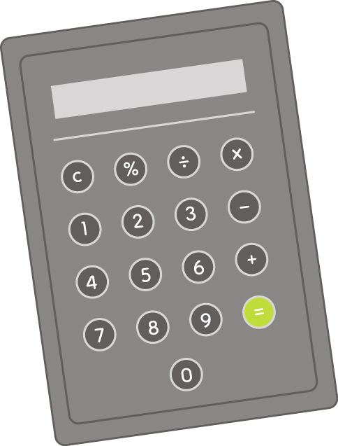
‘Self’? care
‘SELF’ is not ‘alone’!
The Self Care Forum’s definition of Self Care is:
The actions that individuals take for themselves, on behalf of and with others in order to develop, protect, maintain and improve their health, wellbeing or wellness
Self
Services / Community Assets
People

Slide 5
Social Isolation and Loneliness: impact on wellbeing
PHE, Ms Nuzhat Ali

Slide 6
Social Isolation and Loneliness
PHE, Ms Nuzhat Ali

Slide 7
Case Study 1: John and Mary
GP referral:
Mary has poor health. Her husband John has been her main carer but is now struggling with memory loss. He has also been advised by his GP to stop driving which has isolated them further.
Triggers
Disability
Loss
Significant lifestyle changes
Fears
Lost social network
Enablers
Transport
Money
Built Environment
Help with care
Help with housework
Actions
Info and support to access local groups
Info and support on transport schemes
Support provided to claim AA
OTs support to scope ramps for front and back of property and perching stool for kitchen
Info and support to obtain home help and visits form care agencies
Carelink
Outcomes
Mary feels more supported emotionally and physically now that she has regular help at home and states she no longer goes to her GP as often as she did. John is enjoying going to the local Carers Group. They also attend the monthly stroke group. Mary feels more reassured to have the Carelink in place as she worried John would not call for help if she needed it.

Slide 8
Case Study 2: Paula
Paula was referred to Community Connect by the Coordinator of the local Leg Club she attended as she appeared lonely, unkempt and malnourished
Triggers
Bereavement
Loss of job
Loss of income
Disability
Lost social network
Fears
Money worries
Enablers
Money
Built Environment
Physical health
Mental health

Slide 9
Case Study 2: Paula (Contd…)
Actions
Liaised with GP to get support with Paula’s physical and mental health
Obtained grant from local charity for food and property repairs
Enlisted help of Avon and Somerset Fire Service to assess home safety and clear her home of rubbish to improve her built environment
Obtained Food bank vouchers to help Paula try and manage her physical health better
Phone calls to utility companies: EDF, Wessex Water and council tax to manage debts and prevent action being taken
Support with managing debts and claiming benefits to enable Paula to pay bills and buy food
Information from the job centre about entitlement to benefits to improve her financial situation
Referral to WE Care & Repair and home improvement grant to tackle the hoarding at her home
Introduced to local lunch club so that she could have a cooked meal and connect with other people
Call to North Somerset to order recycling bins to assist her to manage her rubbish and built environment moving forwards

Slide 10
Case Study 2: Paula (Contd…)
Outcomes
Paula has had her home cleared of rubbish
Her water is back on
Her garden is due to be cleared
Her leak in his roof is due to be fixed
She attends the local lunch club
She is now on medication from the doctor for her mental health
She has been able to access some money to enable her to pay her bills
Paula states she has reduced her attendance at the GP surgery and now only attends the leg club once a week. The Coordinator of the leg club has reported a huge improvement in Paula’s confidence as she now interacts with other people rather than keeping to herself. She is more positive about her future and feels able to look forward to it and connecting with other people.

Slide 11
Conclusion
The two case studies above show that
Self-Care
(i.e. The actions that individuals take for themselves, on behalf of and with others…)
is useful not only in the prevention of ill health, but also for maintaining and improving people’s wellbeing, and
Can reduce pressure on health services

Slide 12
For more information:
01934 888 803
01275 888 803
communityconnect@curo-group.co.uk
@CC_NSC

